Slide 1
Logic Families

Slide 2
Basic Characteristics of Logic Families
The main characteristics of Logic families include:
  Speed
  Fan-in
  Fan-out
  Noise Immunity
  Power Dissipation

Slide 3
Contt..
Speed: Speed of a logic circuit is determined by the time between the application of input and change in the output of the circuit.
Fan-in: It determines the number of inputs the logic gate can handle.
Fan-out: Determines the number of circuits that a gate can drive.
Noise Immunity: Maximum noise that a circuit can withstand without affecting the output.
Power: When a circuit switches from one state to the other, power dissipates.

Slide 4
Types
TTL – transistor-transistor logic based on bipolar transistors.
CMOS – complementary metal-oxide semiconductor logic based on metal-oxide-semiconductor field effect transistors (MOSFETs).
ECL – emitter coupled logic based on bipolar transistors.

Slide 5
General Characteristics of Basic Logic Families
CMOS consumes very little power, has excellent noise immunity, and is used with a wide range of voltages.
TTL can drive more current and uses more power than CMOS.
ECL is fast, with poor noise immunity and high power consumption.

Slide 6
Complementary metal oxide semiconductor (CMOS)
  most widely used family for large-scale devices
  combines high speed with low power consumption
  usually operates from a single supply of 5 – 15 V
  excellent noise immunity of about 30% of supply voltage
  can be connected to a large number of gates (about 50)
  many forms – some with t_{PD} down to 1 ns
  power consumption depends on speed (perhaps 1 mW

Slide 7
Transistor-transistor logic (TTL)
  based on bipolar transistors
  one of the most widely used families for small- and medium-scale devices – rarely used for VLSI
  typically operated from 5V supply
  typical noise immunity about 1 – 1.6 V
  many forms, some optimised for speed, power, etc.
  high speed versions comparable to CMOS (~ 1.5 ns)
  low-power versions down to about 1 mW/gate

Slide 8
Emitter-coupled logic (ECL)
  based on bipolar transistors, but removes problems of storage time by preventing the transistors from saturating
  very fast operation - propagation delays of 1ns or less
  high power consumption, perhaps 60 mW/gate
  low noise immunity of about 0.2-0.25 V
  used in some high speed specialist applications, but now largely replaced by high speed CMOS

Slide 9
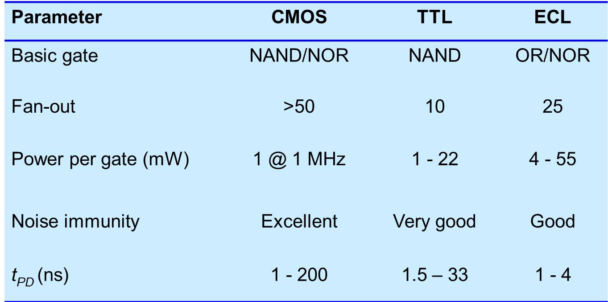
A Comparison of Logic Families

Slide 10
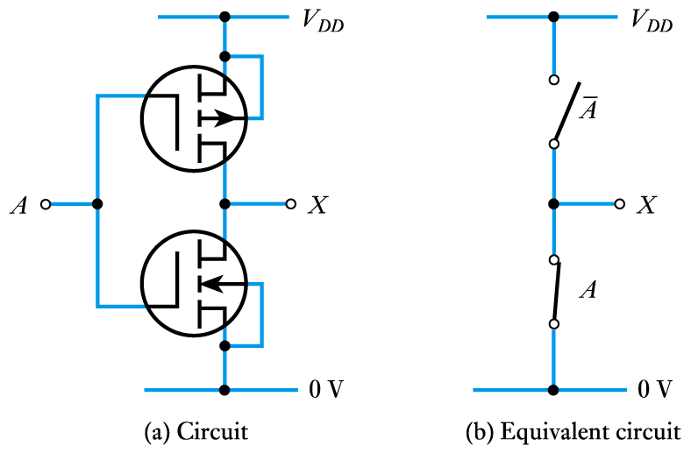
A CMOS inverter

Slide 11
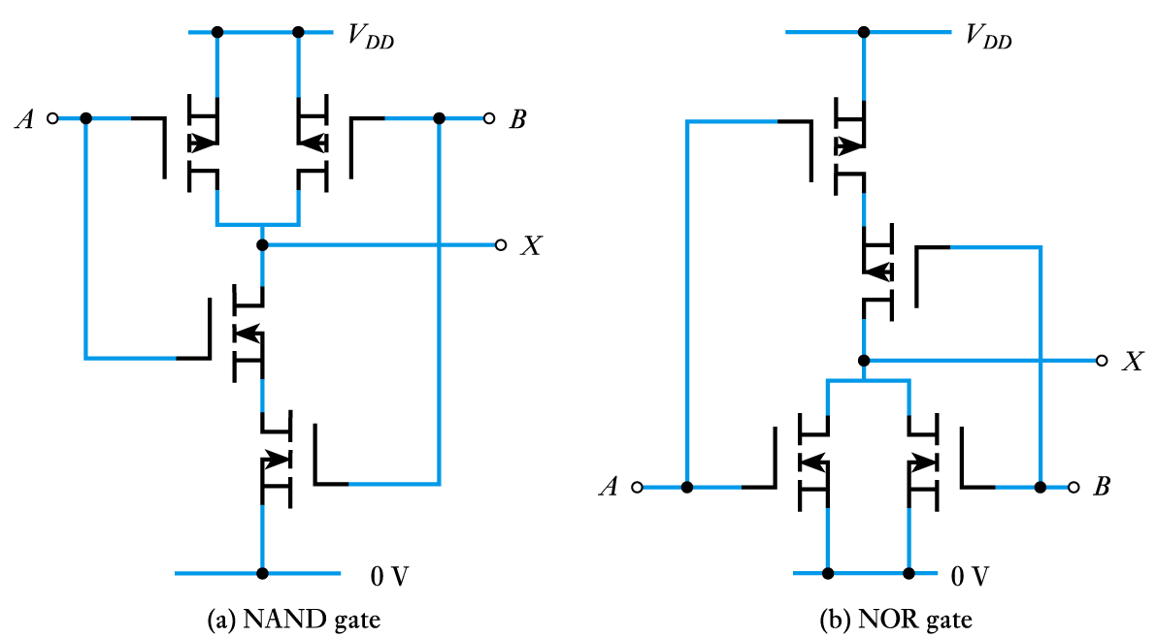
CMOS gates

Slide 12
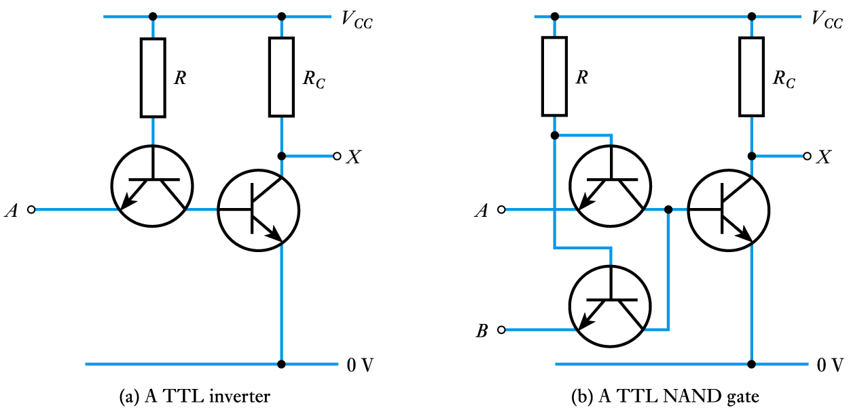
Discrete TTL inverter and NAND gate circuits

Slide 13
Noise immunity
  noise is present in all real systems
  this adds random fluctuations to voltages representing logic levels
  to cope with noise, the voltage ranges defining the logic levels are more tightly constrained at the output of a gate than at the input
  thus small amounts of noise will not affect the circuit
  the maximum noise voltage that can be tolerated by a circuit is termed its noise immunity, V_{NI}

Slide 14
Key Points
Physical gates are not ideal components
Logic gates are manufactured in a range of logic families
The ability of a gate to ignore noise is its ‘noise immunity’
Both MOSFETs and bipolar transistors are used in gates
All logic gates exhibit a propagation delay when responding to changes in their inputs
The most widely used logic families are CMOS and TTL
CMOS is available in a range of forms offering high speed or very low power consumption
TTL logic is also produced in many versions, each optimized for a particular characteristic

